Slide 1




OCCP Set-up Manual

Slide 2

Manual
Table of content
Introduction
Step by step guide to connect your Alfen charging device to Mobiflow

Slide 3
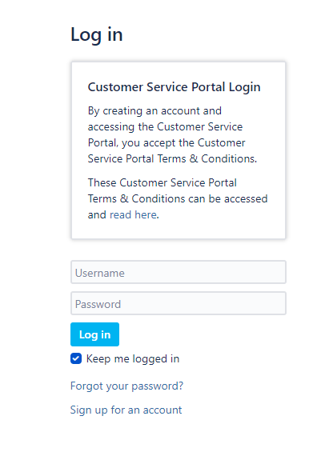
Manual
Introduction
This document describes how you need to connect your Alfen charging device via OCPP to the Mobiflow backend by using the Alfen ACE installer. Please insert the Mobiflow SIM card in the SIM card slot of the Alfen charging device (please consult the device manual for the location of the SIM card slot).
Firstly, you will need to download and install the Alfen ACE installer on your laptop: | Alfen N.V.
Secondly, you will need to request a login and sign up for an account:
Log in - Service Desk (alfen.com)

Slide 4
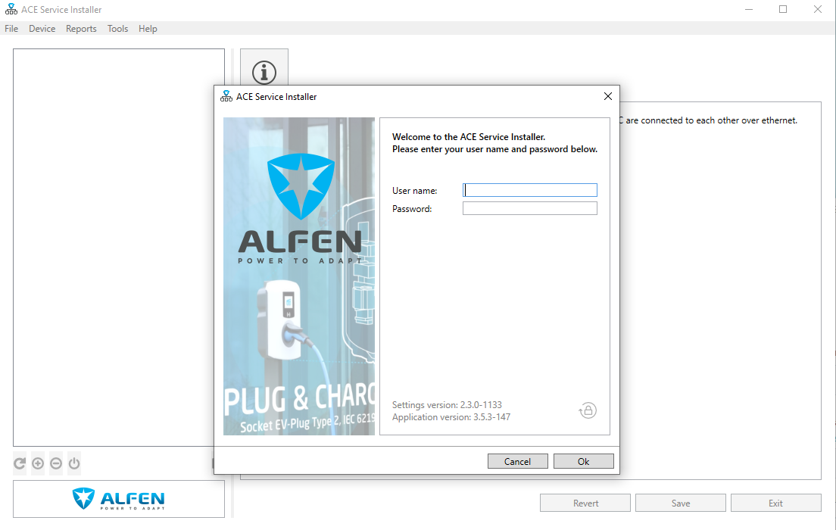
Manual
Step by step guide to connect your Alfen charging device to Mobiflow with the ACE installer
After you have received your login credentials,
open the ACE installer app and log in.

Slide 5
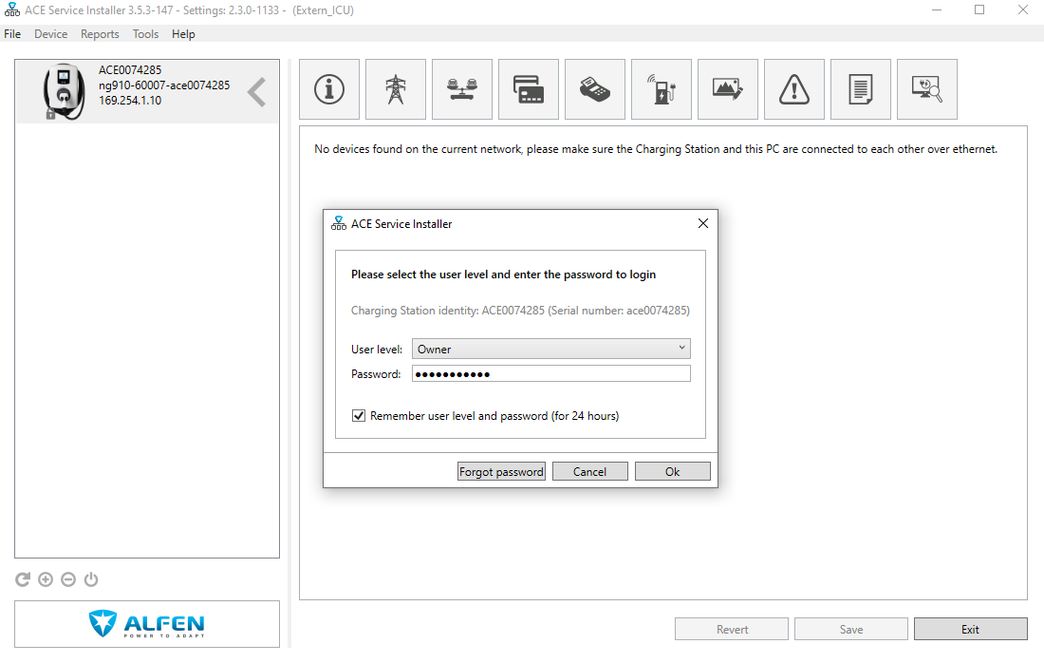
Manual
Step by step guide to connect your Alfen charging device to Mobiflow with the ACE installer
The ACE installer requires a password. This password is specified on a sticker inside the box.
If there is no sticker inside the box containing the password, the password can also be found online in the Alfen webshop. However, the webshop can only be accessed by the person who has ordered the charging device directly from Alfen. If you have bought the device from a wholesaler, it is the wholesaler who is able to access the shop.

Slide 6
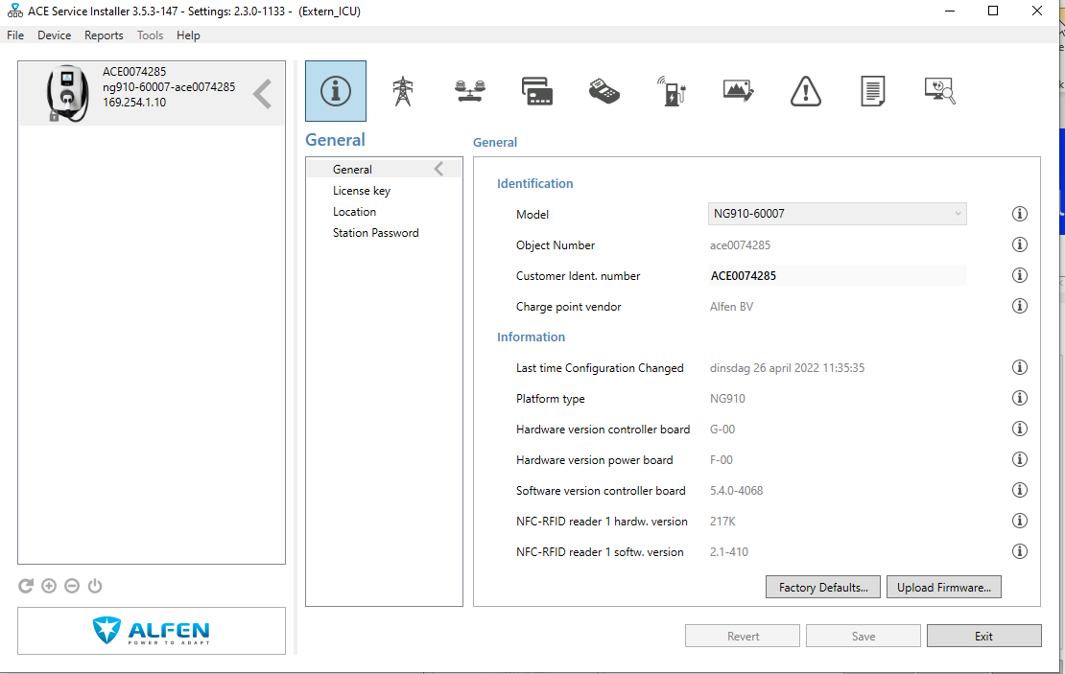
Manual
Step by step guide to connect your Alfen charging device to Mobiflow with the ACE installer
Check the firmware version by clicking on the “Information” button at the top left.
Depending on the firmware you will need to upload Root Certificate A or B (which you can download) on the Mobiflow manual page next to the Alfen logo.
Firmware 4.12 and lower → simpoint A.fwi
Firmware 4.14 and higher → simpoint B.fwi
Press upload firmware.
1.
2.
3.

Slide 7
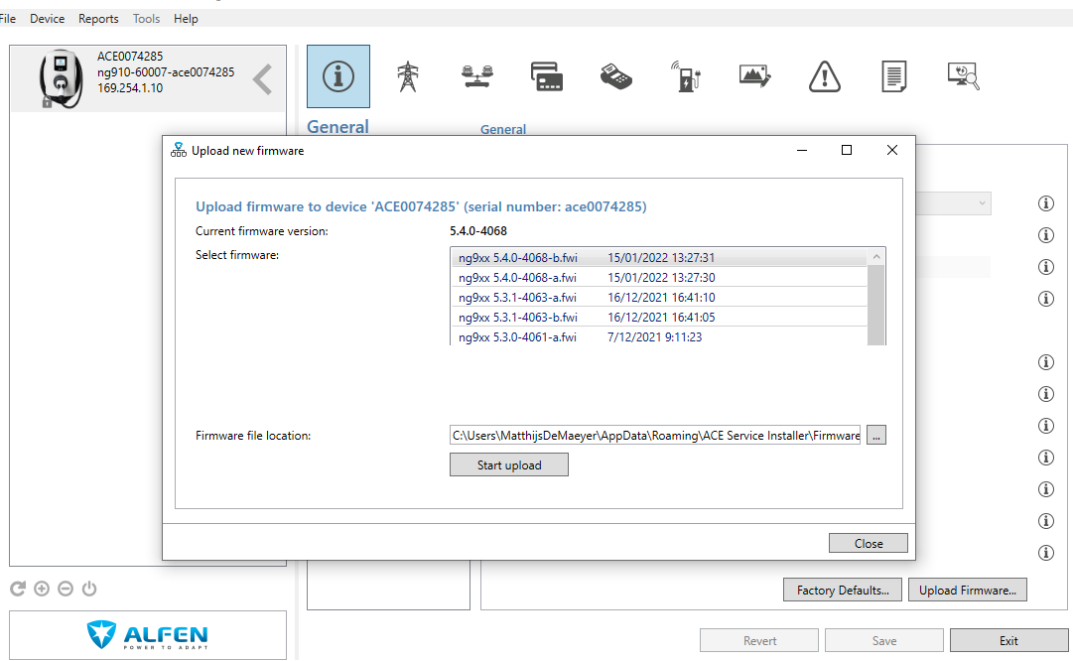
Manual
Step by step guide to connect your Alfen charging device to Mobiflow with the ACE installer
Click on the breadcrumb icon and choose the correct file A or B. Press “Start upload” to upload the Root Certificate.

Slide 8
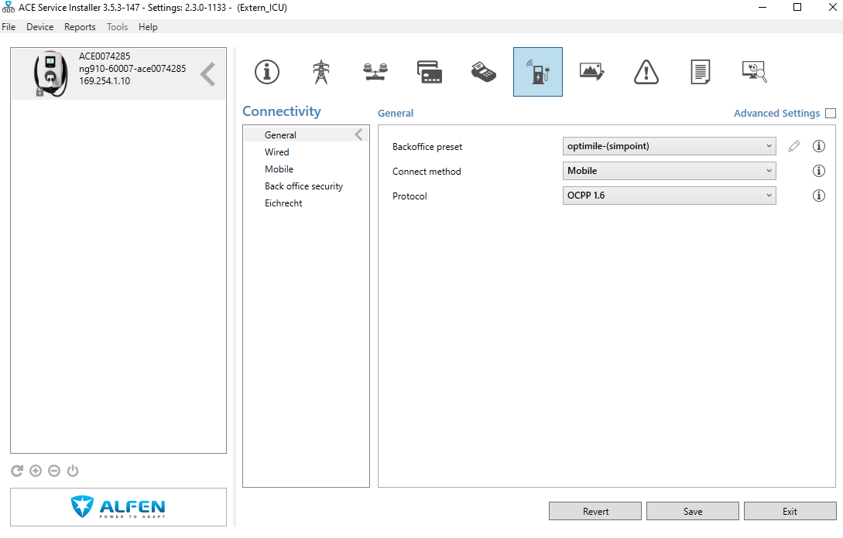
Manual
Step by step guide to connect your Alfen charging device to Mobiflow with the ACE installer
1.
Go to the connectivity tab.
Select the backoffice preset: Optimile Simpoint
Connect method: Mobile
Protocol: OCPP 1.6
! Always click on save below !
2.

Slide 9
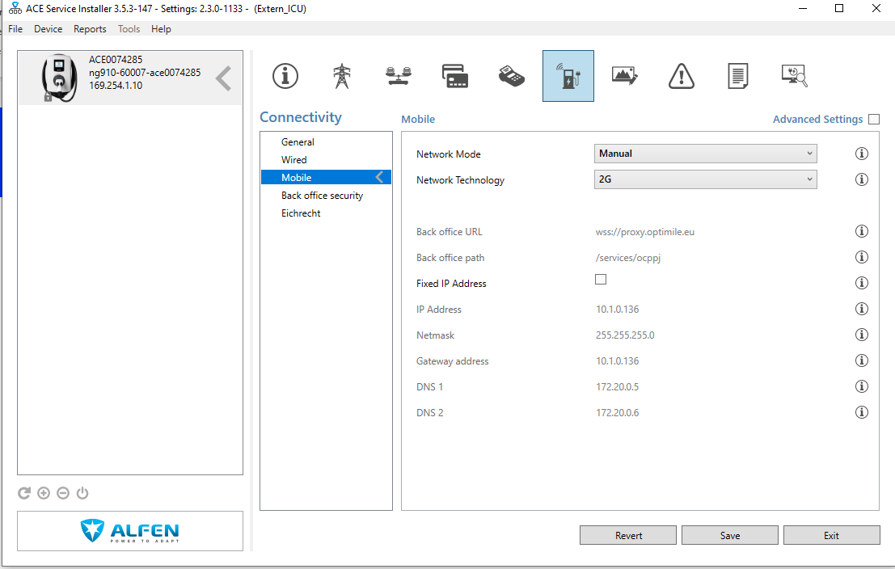
Manual
Step by step guide to connect your Alfen charging device to Mobiflow with the ACE installer
Go to the Mobile tab.
Select Manual and 2G.
! Always click on save below !
2.
1.

Slide 10
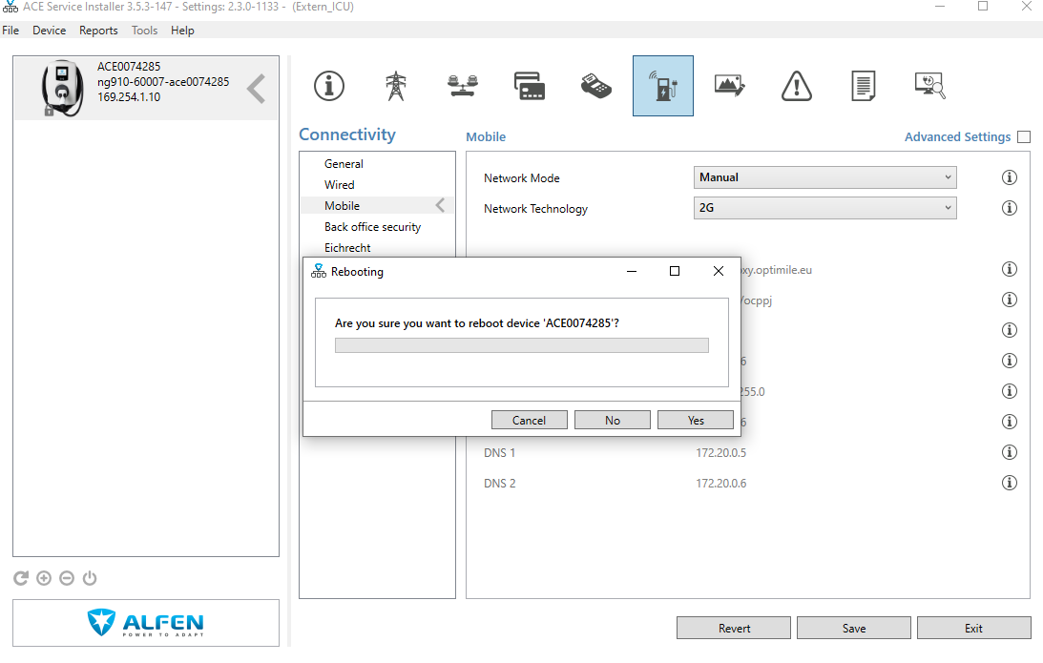
Manual
Step by step guide to connect your Alfen charging device to Mobiflow with the ACE installer
Reboot the device and click “Yes”. The device will restart with all the new settings, but only if you have clicked “Save” after each step.

Slide 11
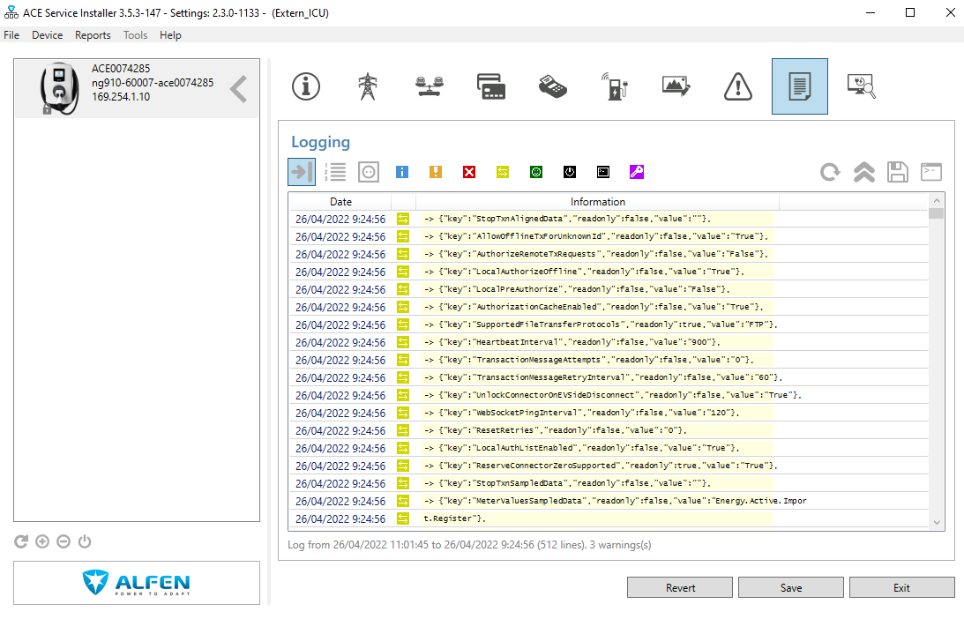
Manual
Step by step guide to connect your Alfen charging device to Mobiflow with the ACE installer
Go to the logging tab to check if there is a connection with the Mobiflow backend.
If you see a lot of green text with a two arrow logo, that means the device is sending data. Refresh the logging if necessary.

Slide 12
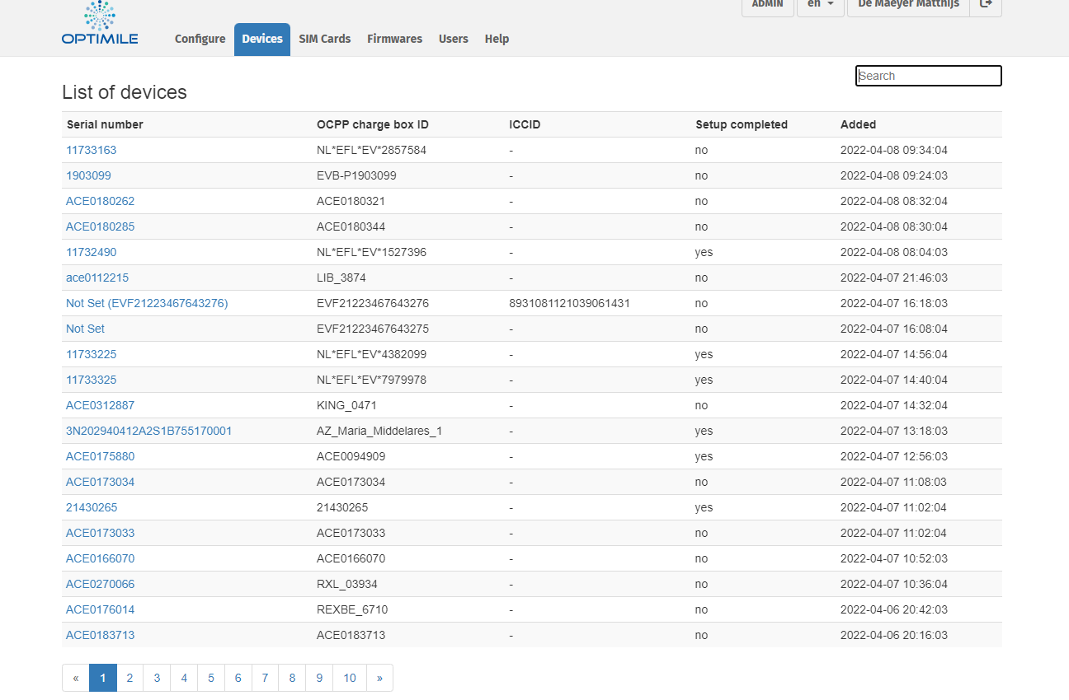
Manual
Step by step guide to connect your Alfen charging device to Mobiflow with the ACE installer
Go to the QA platform* and confirm the device.
* If you do not have a QA login, please check the website to get your login: Toegang tot het QA platform aanvragen | Mobiflow and the QA manual and how to confirm the device.

